Slide 1
Genetics

Slide 2
Genetics: what is it?
What is genetics?
“Genetics is the study of heredity, the process in which a parent passes certain genes onto their children.”
This is the reason that children inherit their biological parents’ genes that express specific traits, such as some physical characteristics, natural talents, and genetic disorders.

Slide 3
Genetic Concepts
Heredity describes how some traits are passed from parents to their children.
The traits are expressed by genes, which are small sections of DNA that are coded for specific traits.
Genes are found on chromosomes.
Humans have two sets of 23 chromosomes— one set from each parent.

Slide 4
Terminologies
Gene: Short functional part of the DNA which holds the information to build and maintain the body.
Allele: Alternative form of a gene found at the same locus on homologous chromosome.
Homozygous: The presence of two identical alleles at a particular locus on a pair of homologous chromosomes.
Heterozygous: The state of having different alleles at a locus on homologous chromosomes.

Slide 5
Dominant: A trait which is expressed in individuals who are heterozygous for a particular allele.
Recessive: A trait which is expressed in individuals who are homozygous for a particular allele.
The dominant allele is expressed and the recessive allele is masked.
Genotype: The genetic constitution of an individual.
Phenotype: The appearance (physical, biochemical, physiological) of an individual which results from the expression of the genotype.

Slide 6
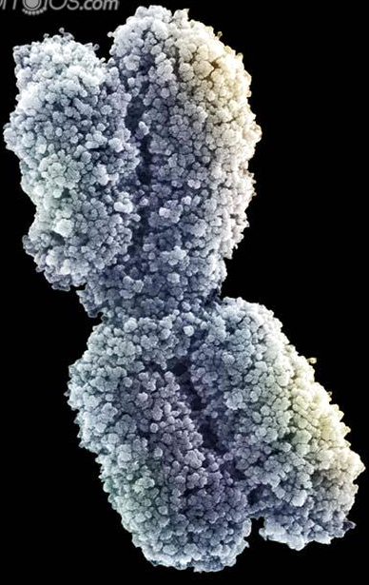
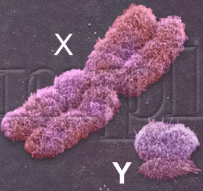
Chromosome
Thread like structure with in the nucleus which carries the units of inheritance.
At the cell division, the tightly coiled, shorter, thicker structure visible under microscope is the chromosome.
In humans, each cell has 23 pairs of chromosome out of which 22 pairs are autosomal while a pair is sex chromosome i.e.: X and Y chromosome.
The no of chromosome is always designated as 2n.

Slide 7
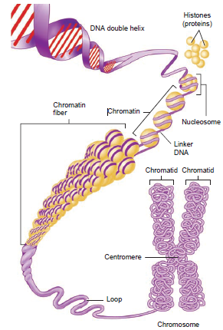
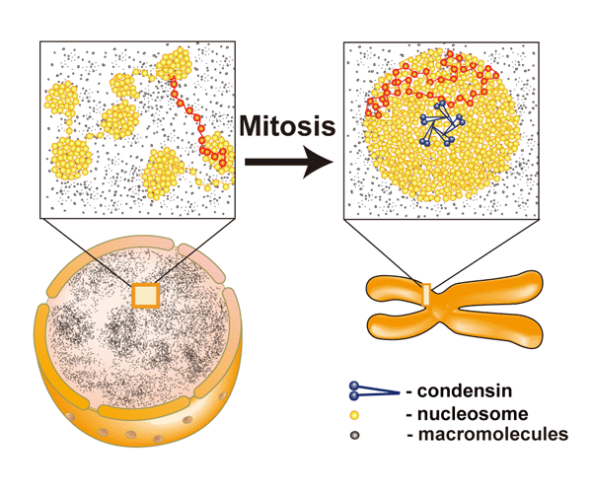

Slide 8
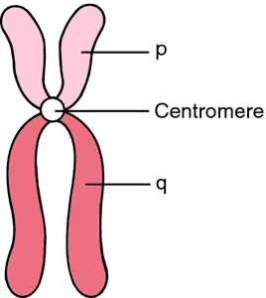
Structure
The average size of chromosome is 5µm at metaphase stage.
When uncoiled, DNA is about few meters long.
The shape is also different at various phases of cell cycle.
Interphase- thin thread like; metaphase- thick, short, rod like while in anaphase- J or V/ rod shaped.

Slide 9
Classification of Chromosomes
According to the position of centromere.
Denver classification (standard classification)
According to position of centromere.
Metacentric- centromere is at center and two arms are equal in length.
Submetacentric- centromere is slightly away from center with unequal arms.
Acrocentric- centromere is close to at end with one long and other short arm. Also have satellite body.
Telocentric- centromere is at one end thus with an arm only.

Slide 10
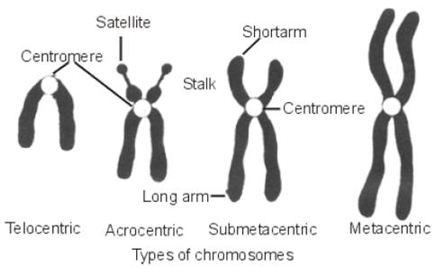
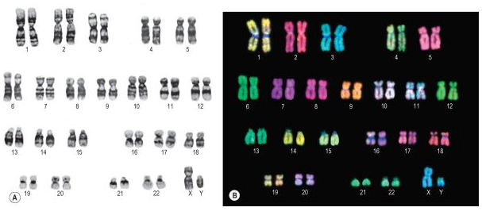

Slide 11
Denver Classification
Chromosomes are divided into seven groups according to their descending length.
The groups are named from A to G.
It is done after the karyotyping of the chromosomes.
X- chromosome belongs to group C, while Y to G group.

Slide 12
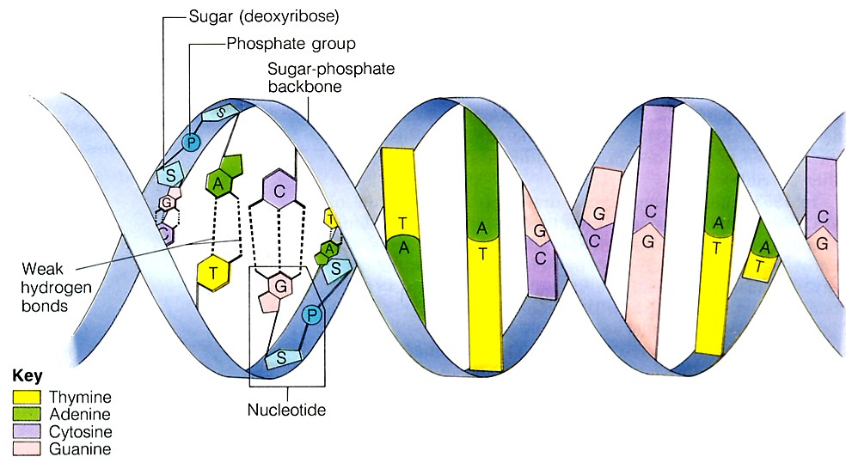
DNA- The Genetic material of Inheritance
The double helical structure made up of long string of nucleotide units attached to one another.
A single nucleotide is made up of : a sugar molecule, a phosphate group and a nitrogenous base.
In DNA, the sugar molecule is called deoxyribose, hence the name deoxyribonucleic acid.

Slide 13
Why DNA is important?
Through the DNA, living organisms pass information along to their offspring.
Due to the double helical structure, it preserves all of the information carrying features of a single DNA strand.
While at the same time introducing elements that make it easier for living cells to make copies of their DNA.
Notes:
Double helical-two strands that wind with each other.

Slide 14
Mutation
Any change in the nucleotide sequence or the arrangement of DNA of an individual.
Mutation may occur in a single gene or in chromosomes.
Mutagens: the agents which causes the mutation.
May be physical or chemical or radiation.
Types of mutation:
Gene/point mutation:
Mutation which alter the individual gene.
Brings the change in the DNA sequence.
Chromosomal mutation:
Changes occurring either in the structure or number of the chromosomes.

Slide 15
Somatic mutation- mutation occurring in the somatic cells.
Non transmittable to offspring.
Produces phenotypical changes in the individual.
Germinal mutation- mutation occurring in the germ cells.
Transmittable to offspring.
Brings the general changes in the individual.

Slide 16
Structural alternation of chromosomes
Translocation- Transfer of genetic material from one chromosome to another.
Deletions-
Insertion- a segment of chromosome is inserted to another.
Inversion-a chromosome rearrangement in which a segment of a chromosome is reversed end to end

Slide 17
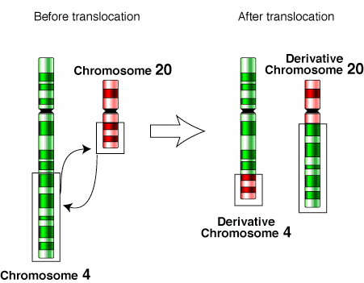

Slide 18
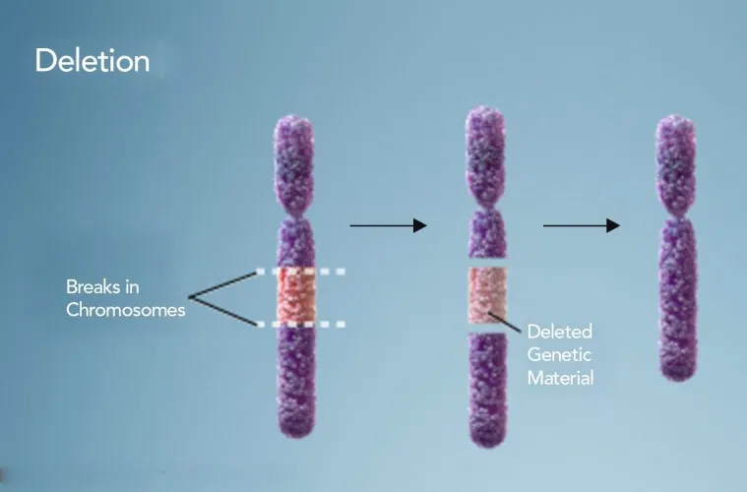

Slide 19
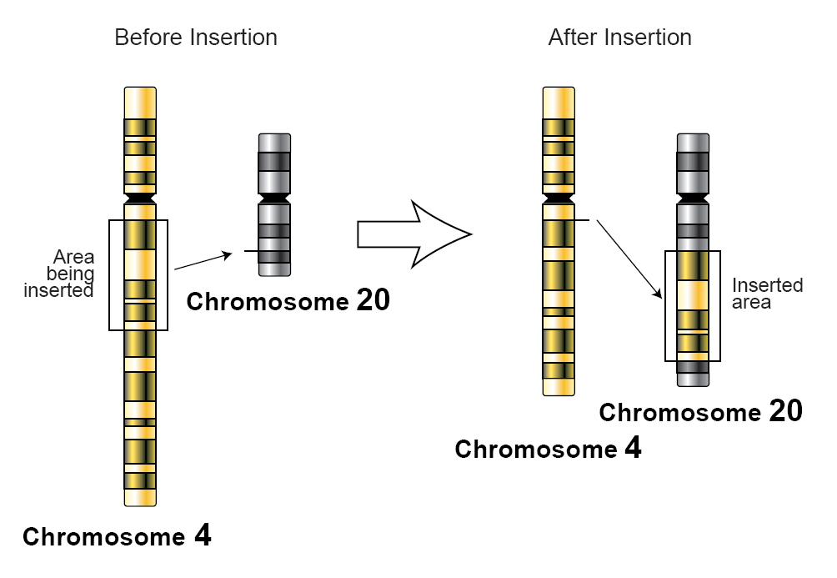

Slide 20
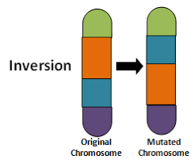

Slide 21
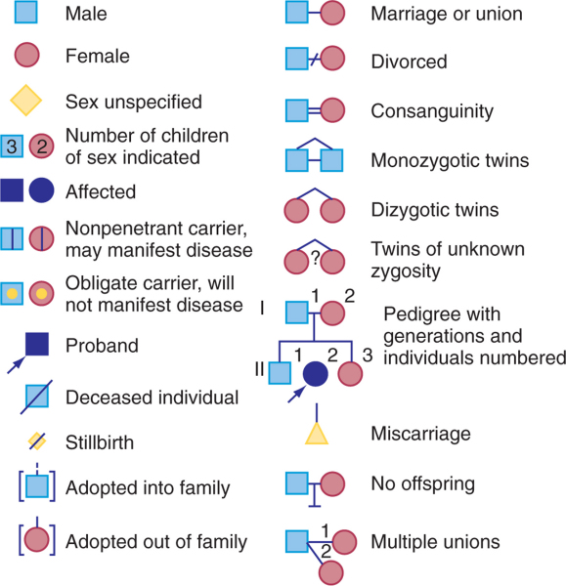
Pedigree chart

Slide 22
Mendelian Inheritance
The inherited traits are determined by genes that are passed from parents to children.
A child inherits two sets of genes—one from each parent.
A trait may not be observable, but its gene can be passed to the next generation.

Slide 23
Mendelian Inheritance
Each person has 2 copies of every gene—one copy from mom and a second copy from dad.
These copies may come in different variations, known as alleles, that express different traits.
For example, 2 alleles in the gene for freckles are inherited from mom and dad:
allele from mom = has freckles (F)
allele from dad = no freckles (f)
child has the inherited gene pair of alleles, Ff
(F allele from mom and f allele from dad).

